Slide 1

Internet of Things
Python & NodeMCU
Serial Communication
IoT Team, BFCAI

Slide 2
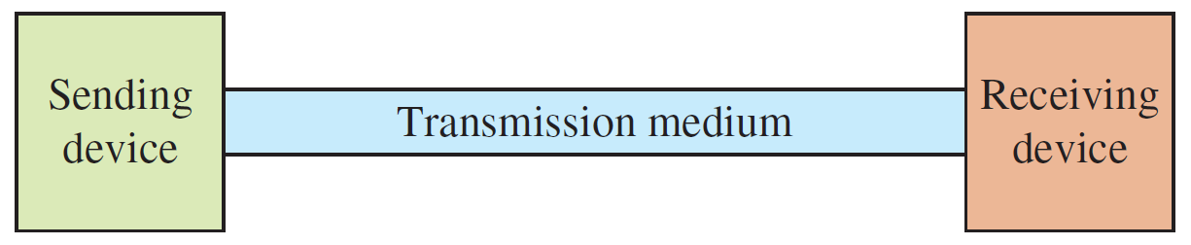
Data Transmission
All data transmission systems in their most basic form have a sending device at one end and a receiving device at the other.

Slide 3
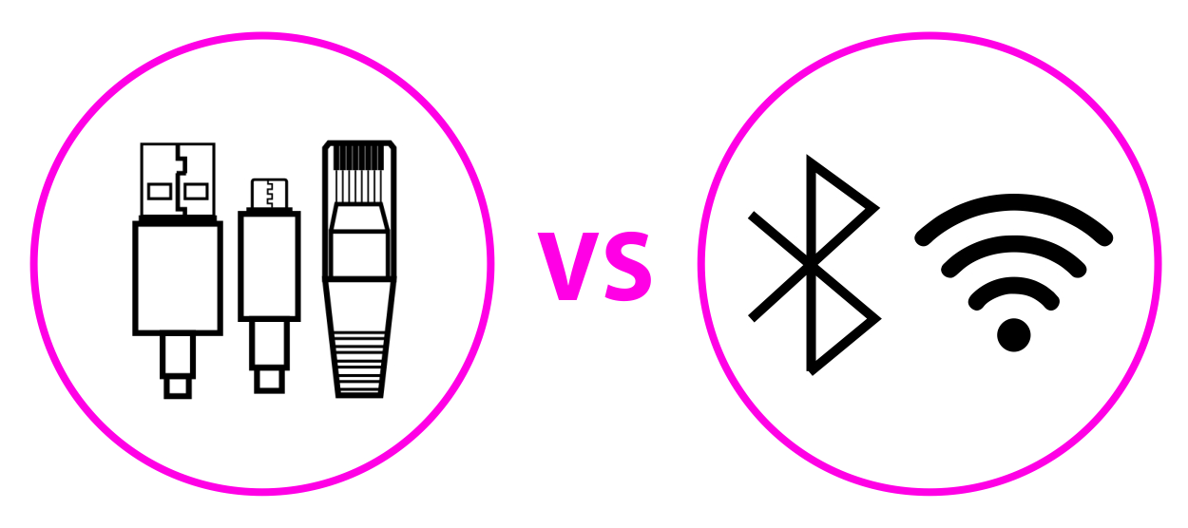
Wired vs. Wireless Communication

Slide 4
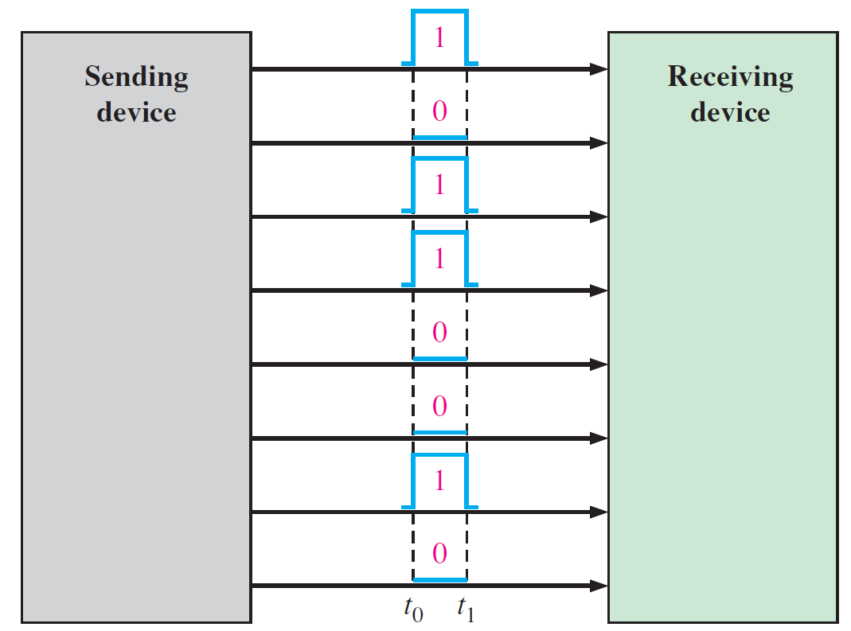
Parallel Communication
In parallel communication, where many bits are sent at the same time.

Slide 5
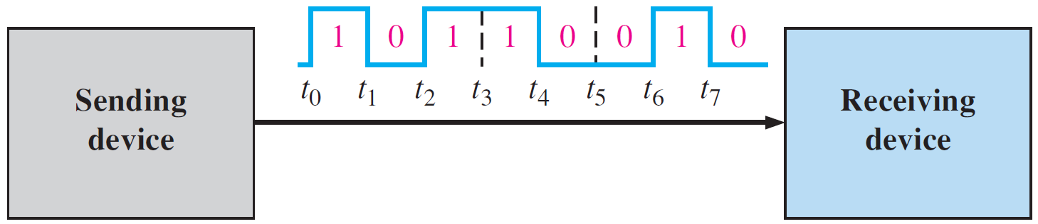
Serial Communication
Serial communication is simply a way to transfer data.
The data will be sent sequentially, one bit at a time.

Slide 6
UART Protocol
UART means “Universal Asynchronous Receiver Transmitter”.
UART represents the hardware circuitry (module) being used for the serial communication.
UART is sold/shipped as a standalone integrated circuit (IC) or as an internal module within microcontrollers.
The UART protocol allows you to communicate between 2 boards.
When you use serial communication between PC and Arduino, you’re using the UART protocol.

Slide 7
UART Protocol: Baud Rate
The baud rate specifies how fast the data is sent over the bus and it is specified in bits-per-second or bps.
You can actually choose any speed for the baud rate.
However, there are specific values that are known as industry standards.
The most common and widely-used standardized value is 9600.
Serial.begin(9600);
In the serial port context, “9600 baud” means that the serial port is capable of transferring a maximum of 9600 bits per second.
Other standard baud rates include: 1200, 2400, 4800, 19200, 38400, 57600 and 115200.

Slide 8
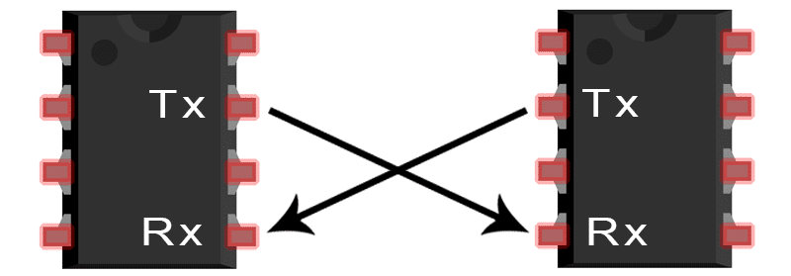
UART Protocol: Transmitter and Receiver
When device A wants to transmit data to device B, it will share data via its transmitter’s pin and device B receiver will receive the sent data.
UART1
UART2

Slide 9
UART Protocol: Transmitter and Receiver
In UART communication, both transmitter and receiver must agree on the exact same baud rate for a successful data transmission.
UART1
UART2

Slide 10
UART Protocol: Data Packet
The data being transmitted/received in UART serial communication is organized into specific blocks called packets.
UART packets usually start with “start bit” which is a logic LOW and is used to signal the receiver that there is a new coming packet.
Data bits are the actual data bits being transmitted to receiver.
Parity bit allows the receiver to check the correctness of the received data.
Stop bits are used to signal the end of the data packet being sent.
Start Bit (1 Bit) | Data Bits (5 to 9 Bits) | Parity Bit (0 to 1 Bit) | Stop Bits (1 to 2 Bits)

Slide 11
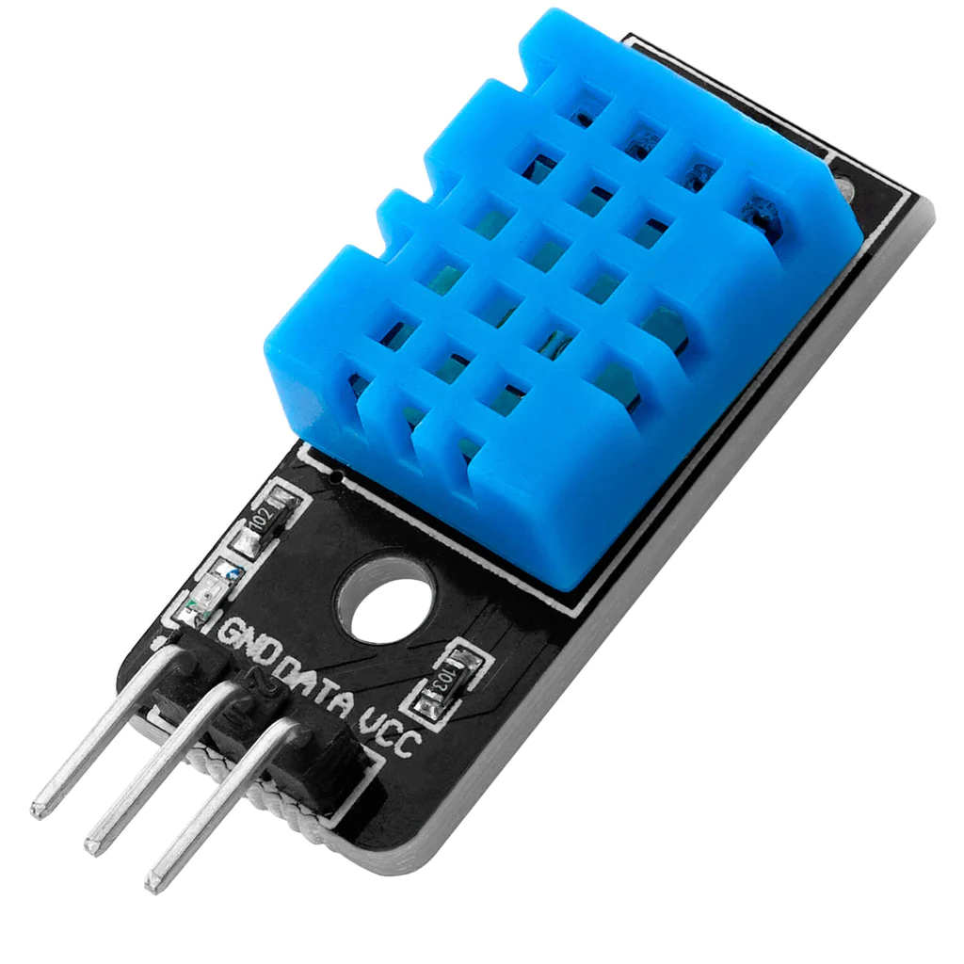
DHT11: Temperature and Humidity Sensor
The DHT11 sensor measures humidity and temperature values serially over a single wire.
It sends a 40-bit data stream containing both temperature and humidity.
8-bit integral RH
8-bit decimal RH
8-bit integral Temp
8-bit decimal Temp
8-bit check sum

Slide 12
DHT11: Specifications
Criteria | Description
Operating Voltage | 3.3V to 5.5V
Communication | Serial
Output Signal | Digital
Temperature Range | 0°C to 50°C
Temperature Accuracy | ±2°C
Humidity Range | 20% to 90%
Humidity Accuracy | ±5%
Refresh Rate | ~ 2 seconds

Slide 13
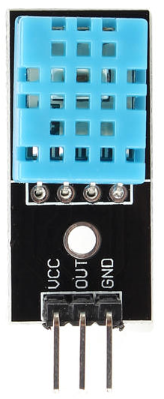
DHT11: Pinout
VCC
S
GND

Slide 14
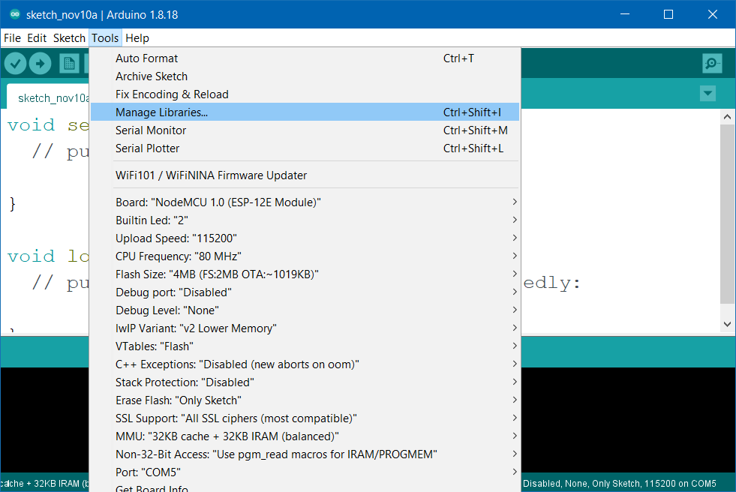

DHT11: Installing Library
Go to Tools → Manage Libraries.

Slide 15
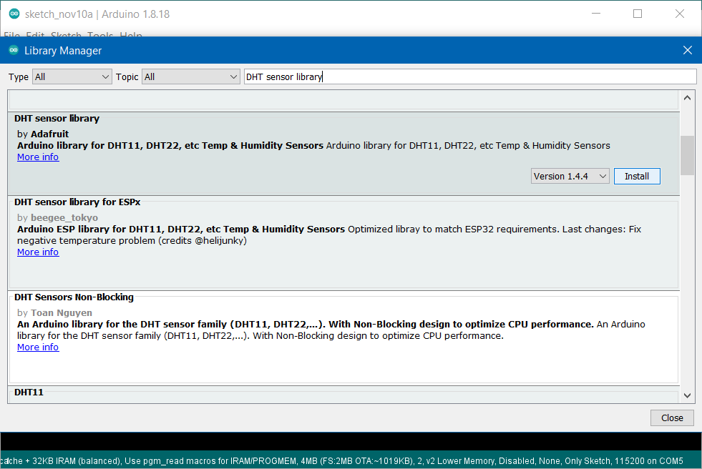
DHT11: Installing Library
Search DHT sensor library by Adafruit, and install it.

Slide 16
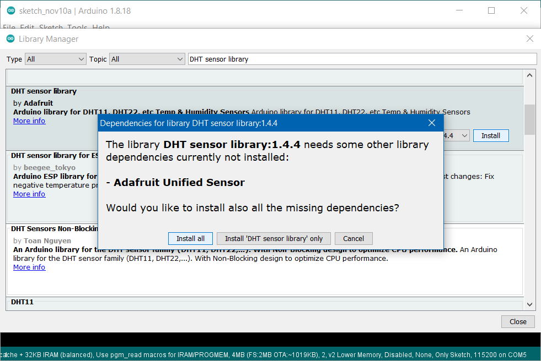
DHT11: Installing Library
Click Install all, if this message appears.

Slide 17
DHT11: Hardware Components
NodeMCU ESP8266
DHT11 Sensor
Jumpers
Breadboard

Slide 18
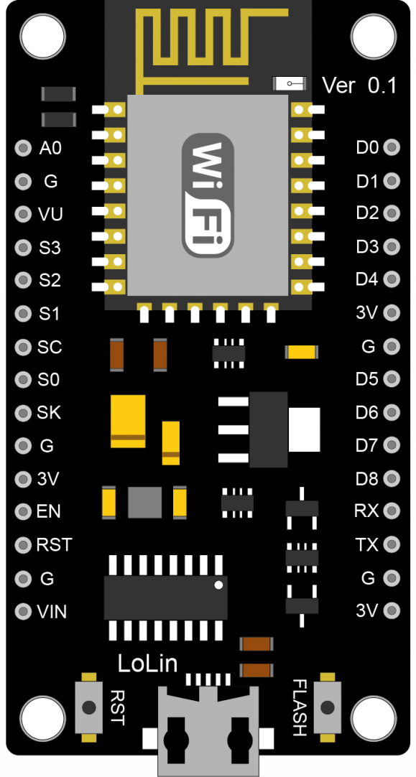



DHT11: NodeMCU ESP8266 Pinout
PIN | GPIO | Why Not Safe?
D0 | GPIO16 | HIGH at boot Used to wake up from deep sleep
D1 | GPIO5 | -
D2 | GPIO4 | -
D3 | GPIO0 | Connected to FLASH button Boot fails if pulled LOW
D4 | GPIO2 | HIGH at boot Boot fails if pulled LOW
D5 | GPIO14 | -
D6 | GPIO12 | -
D7 | GPIO13 | -
D8 | GPIO15 | Required for boot Boot fails if pulled HIGH

Slide 19
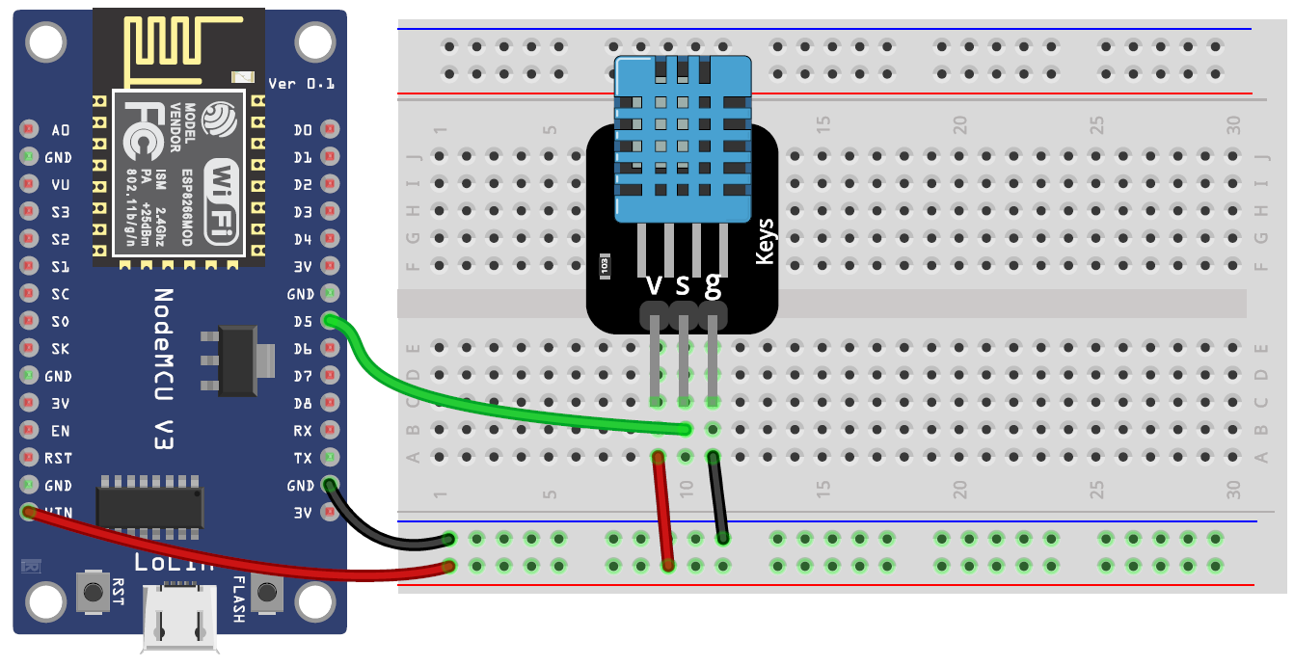
DHT11: Circuit

Slide 20
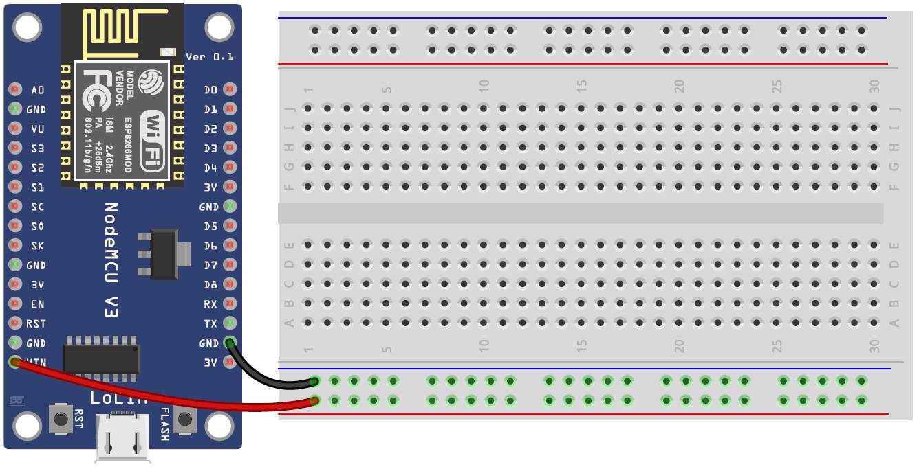
DHT11: Steps
Connect breadboard power (+) and ground (-) rails to NodeMCU VIN and ground (GND), respectively.

Slide 21
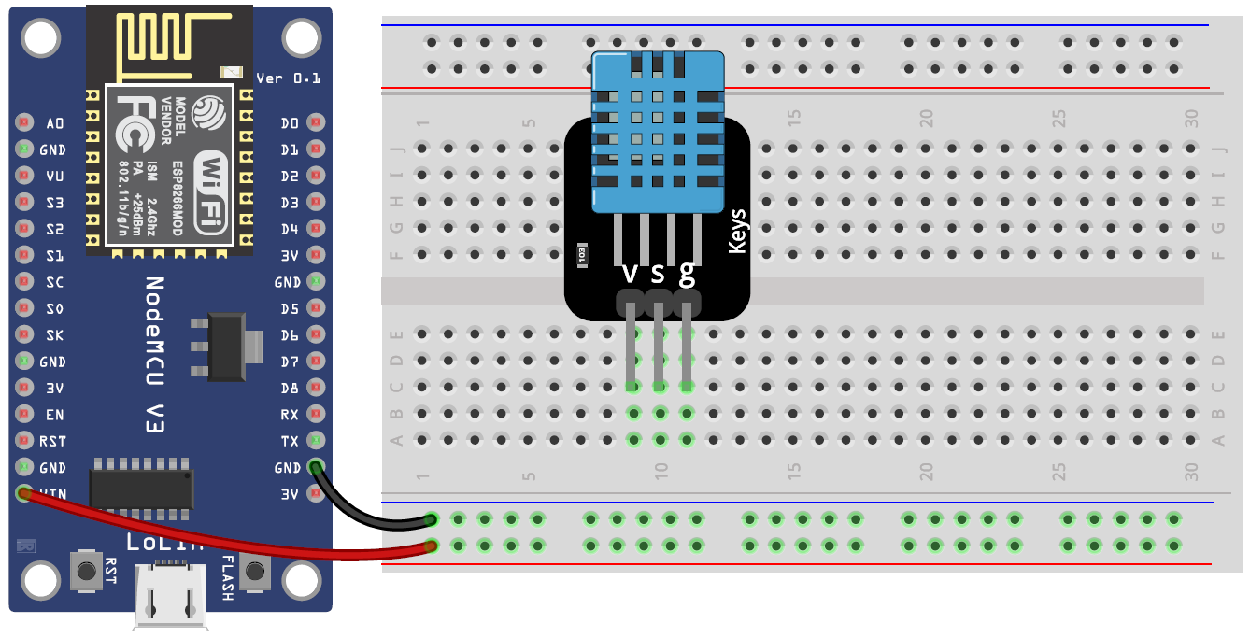
DHT11: Steps
Plug the DHT11 sensor into the breadboard.

Slide 22
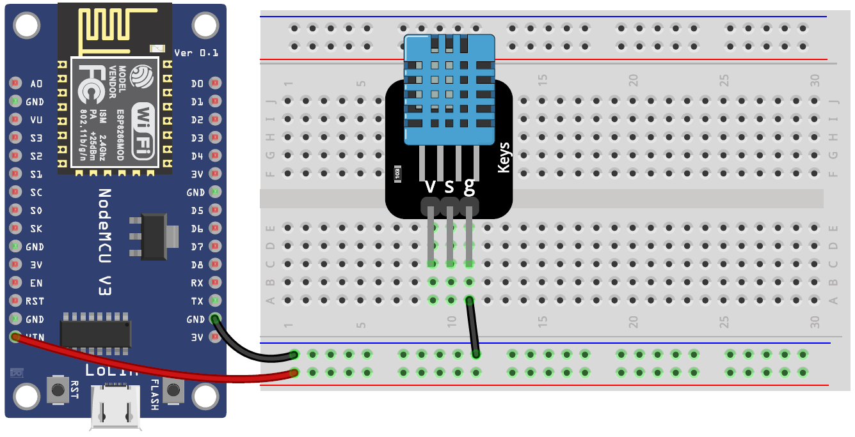
DHT11: Steps
The sensor GND pin connects to the ground on NodeMCU.

Slide 23

DHT11: Steps
The sensor Power pin connects to the VCC on NodeMCU.

Slide 24
DHT11: Steps
Wire up the sensor Data pin to the analog pin D5 on NodeMCU.

Slide 25
DHT11: Code
#include "DHT.h" // Import DHT library
#define DHT_PIN D5 // Digital pin connected to the DHT sensor
DHT dht(DHT_PIN, DHT11); // Initialize DHT sensor
void setup() {
Serial.begin(9600); // Start serial monitor
dht.begin(); // Start DHT sensor
}
void loop() {
delay(2000); // Wait a few seconds between measurements
float h = dht.readHumidity(); // Read humidity
float t = dht.readTemperature(); // Read temperature as Celsius
// Check if any reads failed (to try later)
if (isnan(h) || isnan(t)) {
Serial.println("Failed to read from DHT sensor.");
return;
}
// Print temperature
Serial.print("Temperature: ");
Serial.print(t);
Serial.print("°C ");
// Print humidity
Serial.print("Humidity: ");
Serial.print(h);
Serial.println("%");
}

Slide 26


NodeMCU & Python Serial Communication

Slide 27
NodeMCU & Python Serial Communication
The objective of this part is to establish a serial connection between a Python program and an Arduino/NodeMCU/ESP-32 program.
In the Python program, we will use the PySerial module to be able to establish the serial connection.
The easiest way to install PySerial is by using pip.
>> pip install pyserial
We will need to know the port and the value of baud rate, to be used later in the Python program.

Slide 28

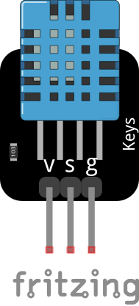
NodeMCU & Python Serial Communication

Slide 29
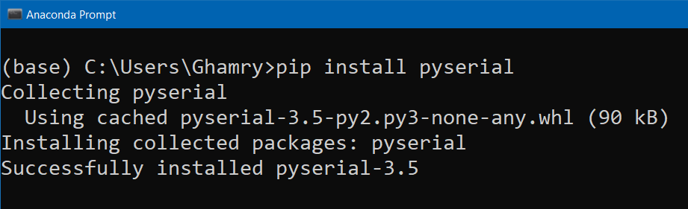
NodeMCU & Python Serial Communication: Installing PySerial
To establish a serial connection between a Python program and an NodeMCU program, you can use the PySerial library, which allows communication with serial ports.
>> pip install pyserial

Slide 30
NodeMCU & Python Serial Communication: Circuit

Slide 31
NodeMCU & Python Serial Communication: NodeMCU Program
#include "DHT.h" // Import DHT library
#define DHT_PIN D5 // Digital pin connected to the DHT sensor
DHT dht(DHT_PIN, DHT11); // Initialize DHT sensor
void setup() {
Serial.begin(9600); // Start serial monitor
dht.begin(); // Start DHT sensor
}
void loop() {
delay(2000); // Wait a few seconds between measurements
float h = dht.readHumidity(); // Read humidity
float t = dht.readTemperature(); // Read temperature as Celsius
// Check if any reads failed (to try later)
if (isnan(h) || isnan(t)) {
Serial.println("Failed to read from DHT sensor.");
return;
}
// Print temperature
Serial.print("Temperature: ");
Serial.print(t);
Serial.print("°C ");
// Print humidity
Serial.print("Humidity: ");
Serial.print(h);
Serial.println("%");
}

Slide 32
NodeMCU & Python Serial Communication: Python Program
# Import the PySerial library for serial communication
import serial
# Initialize serial communication
ser = serial.Serial('COM5', 9600)
try:
while True:
# Check if there is data available in the input buffer
if ser.in_waiting > 0:
# Read all bytes until a newline character is detected
line = ser.readline()
# Decode the bytes into a UTF-8 string
line = line.decode('utf-8', errors='ignore')
# Remove whitespaces from the beginning and the end
line = line.strip()
# Print data
print(line)
except:
# Close the serial connection
ser.close()
print("Serial connection closed.")

Slide 33
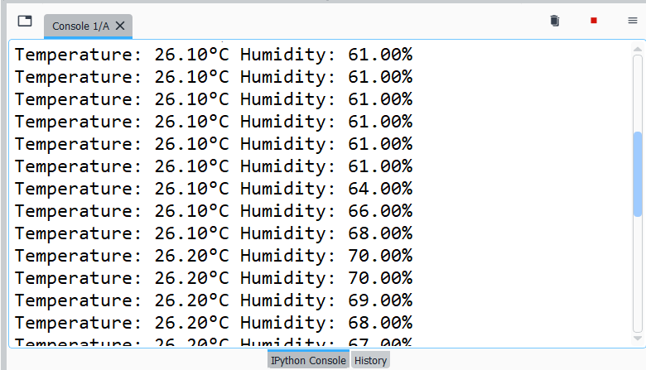
NodeMCU & Python Serial Communication: Output

Slide 34

Python & NodeMCU Serial Communication

Slide 35
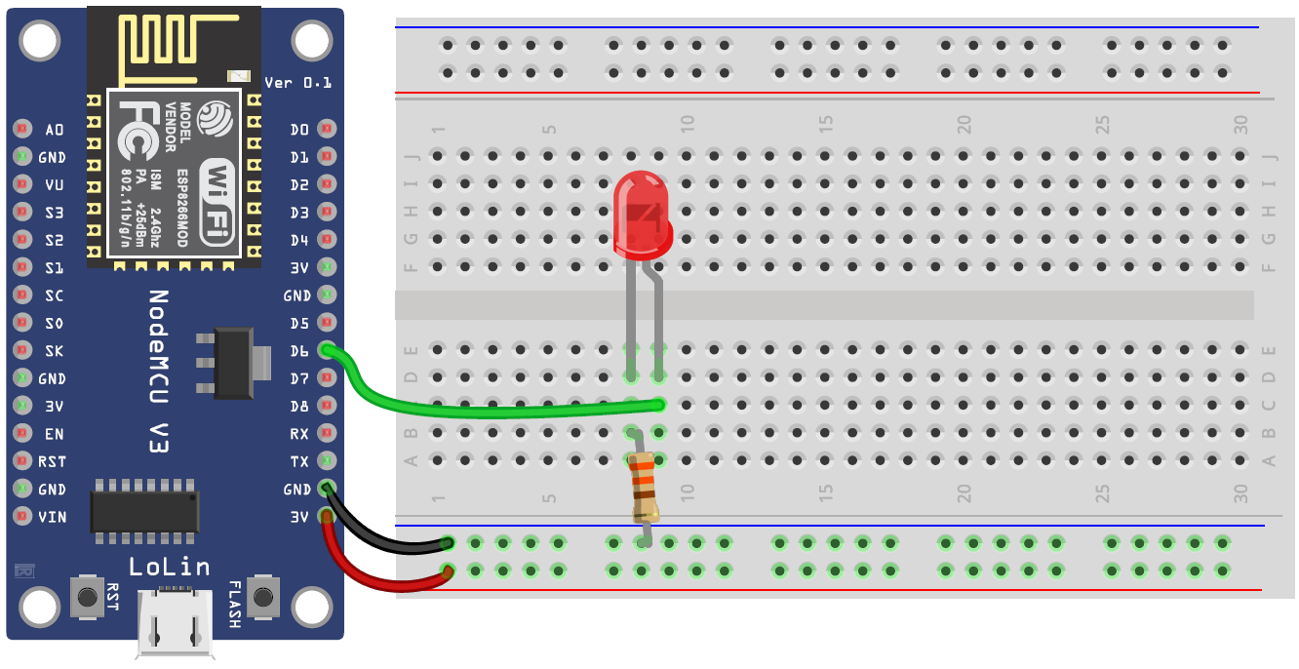
Python & NodeMCU Serial Communication: Circuit

Slide 36
Python & NodeMCU Serial Communication: Python Program
# Import the PySerial library for serial communication
import serial
# Initialize serial communication
ser = serial.Serial('COM5', 9600)
try:
while True:
# Get command from the user
cmd = input('Enter the command: ')
# Send command to NodeMCU
ser.write(cmd.encode())
except:
# Close the serial connection
ser.close()
print("Serial connection closed.")

Slide 37
Python & NodeMCU Serial Communication: NodeMCU Program
#define LED_PIN D6 // Define LED pin
void setup() {
Serial.begin(9600); // Start serial monitor
pinMode(LED_PIN, OUTPUT); // Initialize the pin D6 as an output
}
void loop() {
// Read the incoming byte if available
if(Serial.available()){ // Check if there is a message available
char cmd = Serial.read(); // Read the incoming byte
if(cmd == '1') // If command is '1'
digitalWrite(LED_PIN, HIGH); // Turn on LED
else if(cmd == '0') // If command is '0'
digitalWrite(LED_PIN, LOW); // Turn off LED
}
}

Slide 38

Voice-Controlled Lamp

Slide 39
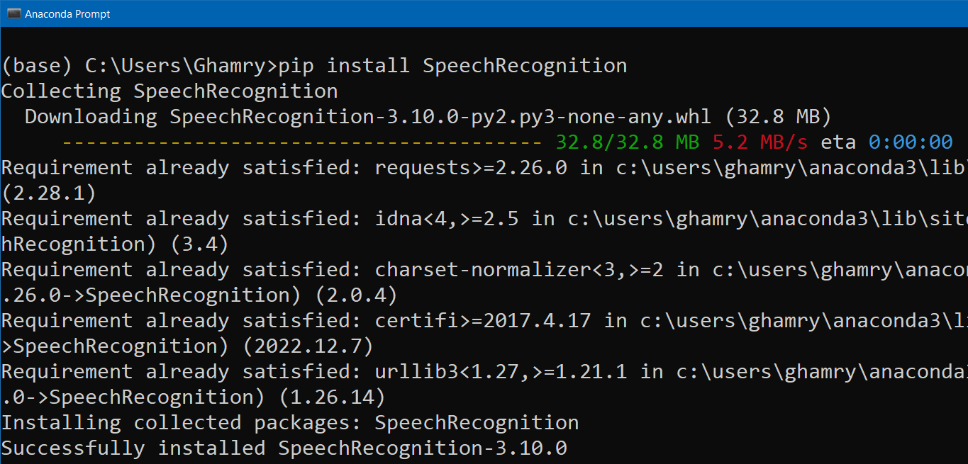
Voice-Controlled Lamp: Installing SpeechRecognition
To convert speech to text in Python, you can use SpeechRecognition library, which provides an interface to various speech recognition engines.
>> pip install SpeechRecognition

Slide 40
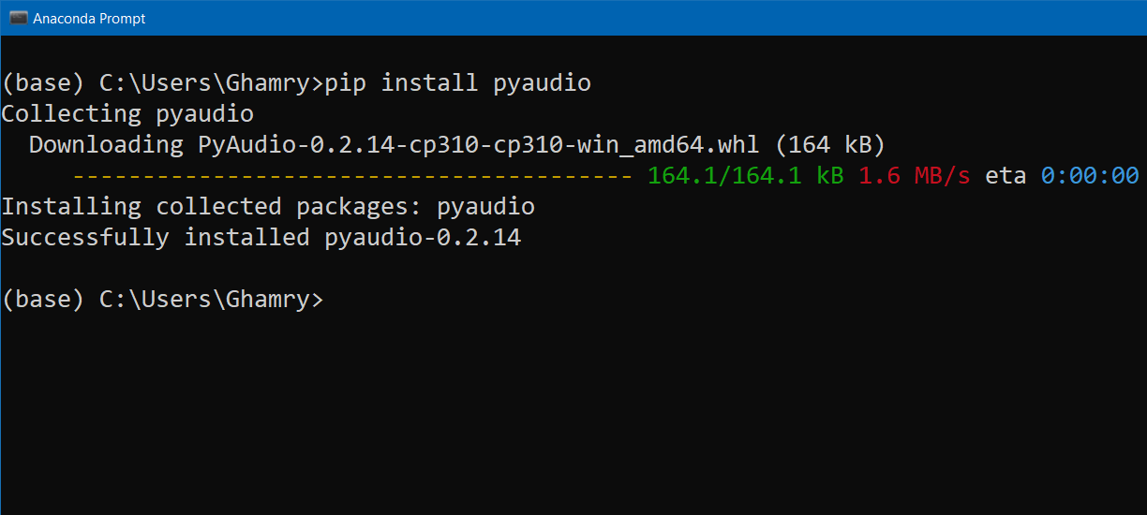
Voice-Controlled Lamp: Installing PyAudio
The SpeechRecognition library relies on PyAudio library.
>> pip install pyaudio

Slide 41
Voice-Controlled Lamp: Python Program
import serial
import speech_recognition as sr
ser = serial.Serial('COM5', 9600) # Initialize serial communication
recognizer = sr.Recognizer() # Initialize the recognizer
try:
while True:
try:
# Capture audio from the microphone for 2 seconds
with sr.Microphone() as source:
print("Say something.")
audio = recognizer.listen(source, phrase_time_limit=2)
# Use Google Web Speech API to recognize the speech
print('Processing voice ...')
text = recognizer.recognize_google(audio, language='ar-EG')
print(f'You said: {text}')
# Send command to NodeMCU
if text == 'نور اللمبه':
ser.write('1'.encode())
elif text == 'اطفي اللمبه':
ser.write('0'.encode())
except sr.UnknownValueError:
print("Google Web Speech API could not understand audio.")
except sr.RequestError:
print("Could not request results from Google Web Speech API.")
finally:
repeat = input('\nRepeat? ')
except:
ser.close()
print("Serial connection closed.")

Slide 42
Voice-Controlled Lamp: NodeMCU Program
#define LED_PIN D6 // Define LED pin
void setup() {
Serial.begin(9600); // Start serial monitor
pinMode(LED_PIN, OUTPUT); // Initialize the pin D6 as an output
}
void loop() {
// Read the incoming byte if available
if(Serial.available()){ // Check if there is a message available
char cmd = Serial.read(); // Read the incoming byte
if(cmd == '1') // If command is '1'
digitalWrite(LED_PIN, HIGH); // Turn on LED
else if(cmd == '0') // If command is '0'
digitalWrite(LED_PIN, LOW); // Turn off LED
}
}

Slide 43
References and Tutorials
DHT11 Sensor Interfacing with NodeMCU
Interfacing of DHT11 Sensor With ESP8266 nodemcu
DHT11 Temperature & Humidity sensor on NodeMCU
Interface DHT11 DHT22 with NodeMCU Using Web Server
ESP8266 DHT11/DHT22 Temperature and Humidity Web Server
pySerial Documentation
ESP32 / ESP8266 Arduino: Serial communication with Python
Raspberry Pi Arduino Serial Communication
The Ultimate Guide To Speech Recognition With Python
A Guide to Speech Recognition in Python

